Slide 2
No bias mode
Direction of flow of charge carrier | Type of current | Direction of current
← | electron diffusion | →
→ | hole diffusion | →
→ | electron drift | ←
← | hole drift | ←
At equlibrium the net current across the junction is zero.

Slide 3
Forward bias
If the diode's P-side is connected to higher potential and N-side to lower potential then the diode is forward biased.
When the diode is forward biased, the -ve terminal of battery repels the electrons of N-side towards the junction & move into depletion region. It merged with positive ions & converts positive ions into neutral donor atom.
Similarly +ve terminal of battery repels the holes of P-side towards the junction & move into depletion region. It merged with negative ions & converts negative ions into neutral acceptor atom.
In response to that the depletion region width decreases so as contact potential.
The junction offers low resistance (forward resistance, R_{F}) to the flow of current through it, because of large number of carriers present in whole of the diode. This R_{F} is of the order of a few unit ohms.
As we increase the applied voltage between diode, the majority carrier starts flowing and current appears across junction.
The minimum forward bias voltage from which the current starts increasing in p-n diode is called threshold voltage or knee voltage.

Slide 4
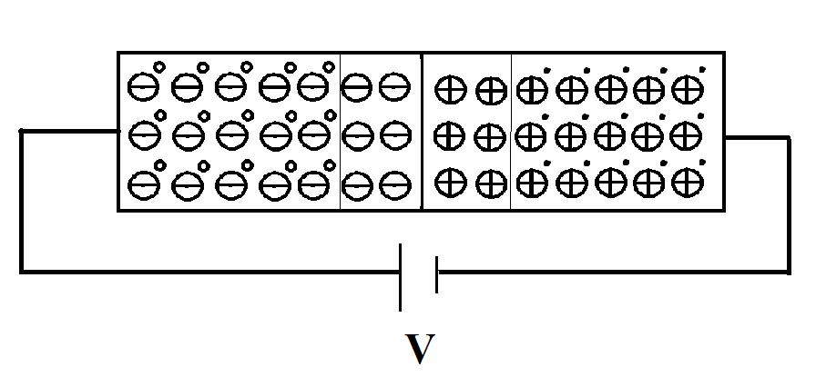
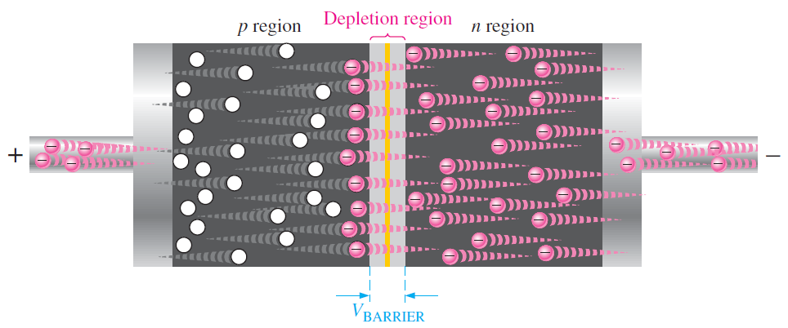
Forward Bias

Slide 5
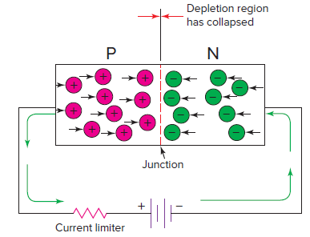
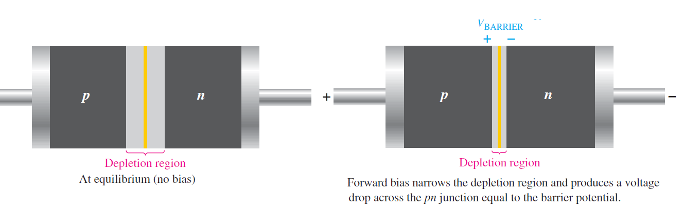
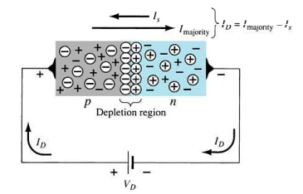

Slide 6
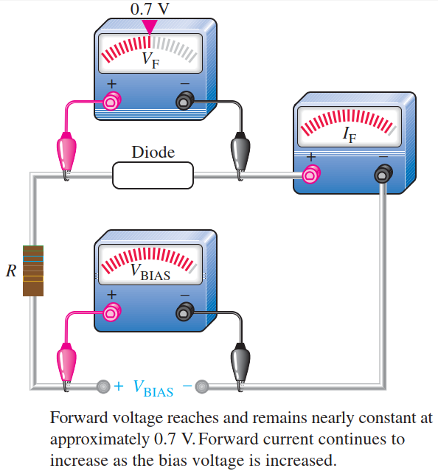
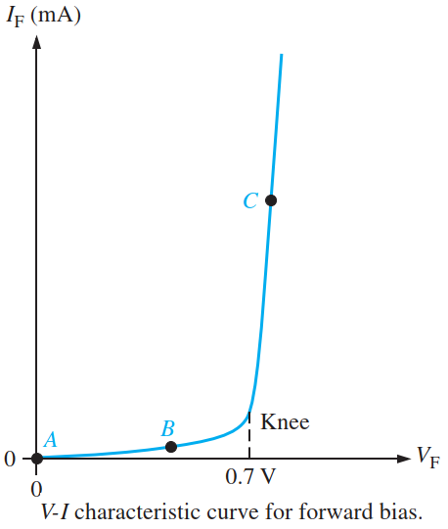
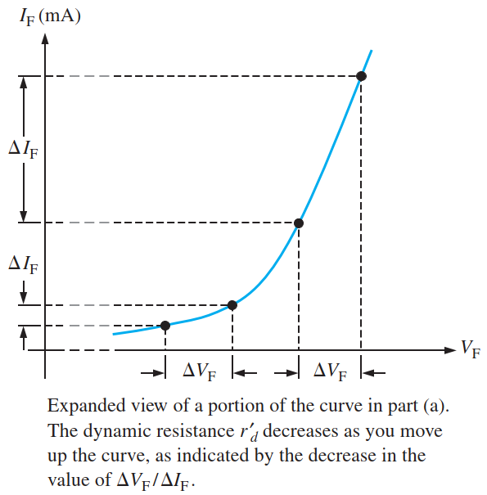
I-V characteristic under Forward bias condition
In forward bias, the current through the diode is called as a forward current.

Slide 7
Reverse bias
If the diode's N-side is connected to higher potential and P-side to lower potential then the diode is reversed biased.
In this configuration, the free electrons in the n-type material are attracted toward the positive terminal of the external voltage source.
It increases the number of positive immobile ions in the n side of the p–n junction.
Electrons from the negative terminal of voltage source also enters at the p-side of semiconductor. The electron combines the holes of the p-type semiconductor. In other words we can say negative terminal of battery attract holes from p side, so holes move away from junction, which results in increase of negative charge ions in p-side. which causes increase in width of depletion layer on p-side
In response to that the depletion region width increases so as contact potential.
The depletion layer stops growing when its difference of potential equals the applied reverse voltage. When this happens, electrons and holes stop moving away from the junction.

Slide 8
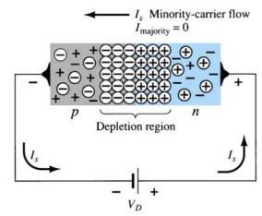
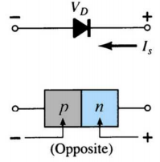

Slide 9
Reverse bias
As we increase the applied voltage between diode,the majority carreir movement stops and current appears across junction is zero due to majority carriers.
Under thermal energy, hole and free electrons can be created inside the depletion layer of a reverse-biased diode.
The electric field due to the depletion region, drives the minoity carriers to flow.
The minority carriers flow gives current opsite to conventional current i.e N-side to P-side.
This current is called leakge current “ I_{s} “.

Slide 10
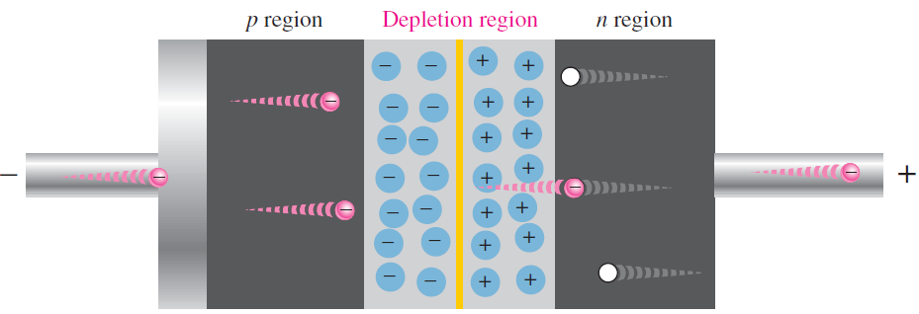
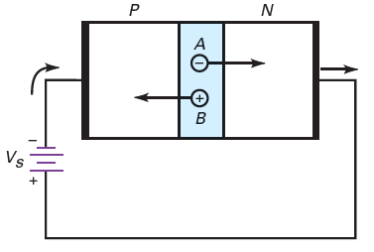
The free electron at A and the hole at B can now contribute to reverse current. Because of the reverse bias, the free electron will move to the right, effectively pushing an electron out of the right end of the diode. Similarly, the hole will move to the left.

Slide 11
Breakdown region of a diode
This parameter of diode is defined as how much reverse voltage a diode can withstand before it is destroyed.
Once the breakdown voltage is reached, a large number of the minority carriers suddenly appears in the depletion layer and the diode conducts heavily.
When the reverse voltage increases, it forces the minority carriers to move more quickly. These minority carriers collide with the atoms of the crystal.
When these minority carrier have enough energy, it can knock valance electron and generate a free electron.
The process is geometric progression because one free electron liberates one valence electron to get two free electrons. These two free electron produce another two free electron and this process will continue.
Due to the free electrons, heavy current flows through the diode.

Slide 12
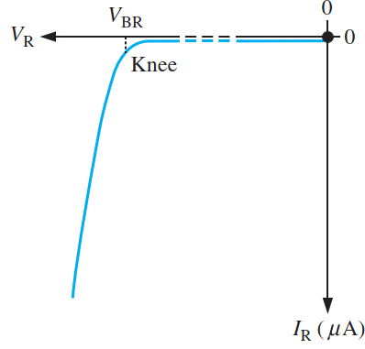
The multiplication of conduction electrons during reverse bias state is known as the avalanche effect, and reverse current can increase dramatically if steps are not taken to limit the current. That will permanently damage the diode.
The breakdown voltage for a diode depends on the doping level, which the manufacturer sets, depending on the type of diode. A typical rectifier diode (the most widely used type) has a breakdown voltage of greater than 50 V.
The maximum reverse-bias potential that can be applied before entering the breakdown region is called the peak inverse voltage (referred to simply as the PIV rating) or the peak reverse voltage (denoted by PRV rating).

Slide 13
V-I characteristics
The plot between current and voltage of P-N junction diode is called as V-I charecteristics of diode.
.” I ” is defiened as current flowing through diode from P to N.
“ V “ is defiened as voltage across terminals of diode with positive at p side.
In F.B condition,V < V_{t}, current is very small.
When,V > V_{t}, current increases sharply.
Generally the thresold voltage for Silicon is 0.7V and for Germanium is 0.3V.
V_{t}

Slide 14
V-I characteristics
At reverse bias voltage, after point 'P' shown in figure, reverse current increases suddenly and almost parallel to y-axis.
This region 'PQ' shown in figure is called breakdown region and diode may damage in this region.
The maximum reverse voltage that can be applied to the PN junction without damage to the diode is called peak inverse voltage (PIV).
P
V_{t}
Q

Slide 15
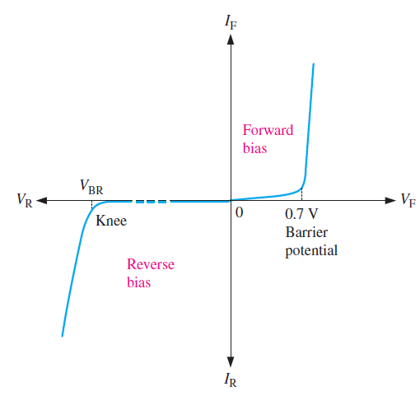
Complete I-V characteristic curve

Slide 16
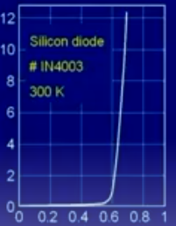

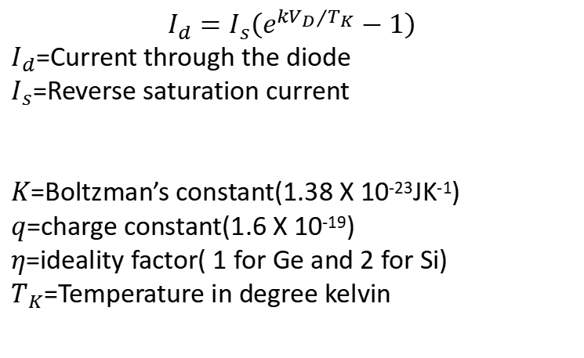
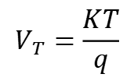
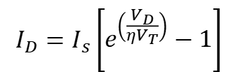
The Complete V-I Characteristic Curve
$$I_{d}=I_{s}\left(e^{k{V_{D}}/{T_{K}}}−1\right)$$
$I_{d}$=Current through the diode
$I_{s}$=Reverse saturation current
$K$=Boltzman’s constant(1.38 X 10⁻²³JK⁻¹)
$q$=charge constant(1.6 X 10⁻¹⁹)
$η$=ideality factor( 1 for Ge and 2 for Si)
$T_{K}$=Temperature in degree kelvin
$$\text{k}=\frac{q}{ηK}=\frac{11600}{η}$$
Current through diode( I_{D} ) in mA
$$I_{D}=I_{s}\left[e^{\left(\frac{V_{D}}{ηV_{T}}\right)}−1\right]$$
$$V_{T}=\frac{KT}{q}$$
Voltage across diode( V_{D} in V)

Slide 17
V-I characteristics

Slide 18
Effect of temperature on reverse saturation current
The higher the junction temperature, the greater the saturation current.
A useful approximation to remember is this: I_{S} doubles for each 10°C rise.
The change in saturation current is 7 percent for each Celsius degree rise.
$$Percentage ΔIs=100\%\text{​ }for {10}^{0} increase of temperature$$
$$Percentage ΔIs=7\%\text{​ }per ^{0}C rise of temperature$$

Slide 19
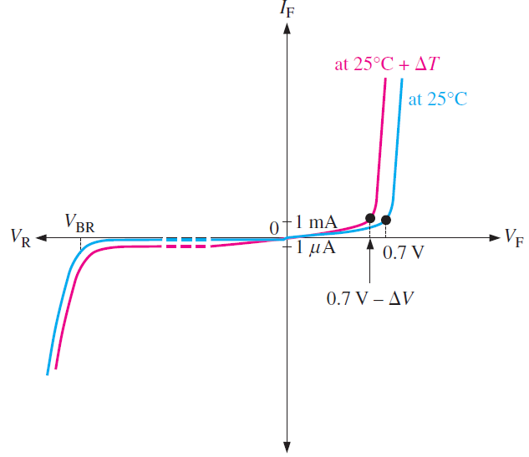
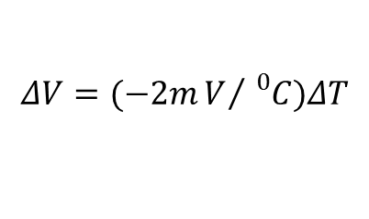
Effect of temperature on barrier potential:
When the diode is conducting, the junction temperature is higher than the ambient temperature because of the heat created by recombination.
An increase in junction temperature, creates more free electrons and holes in the doped regions, it causes narrower of depletion region
Less barrier potential at higher junction temperatures
The barrier potential of a silicon diode decreases by 2 mV for each degree Celsius rise.
$$ΔV=(−2mV/{{}_{}^{0}C})ΔT$$

Slide 20
Effect of temperature on V-I characteristics
The reverse saturation current I_{s} nearly doubles for every 10⁰ C rise in temperature.
When temperature increases by 1⁰ C, the junction voltage drops by -2.5 mV.

